Slide 1
Cryptographic techniques
Adelaiye o. i.

Slide 2
PUBLIC Key ENCRYPTION
ASYMMETRIC CRYPTOGRAPHY

Slide 3
Public Key Encryption
With the spread of more unsecure computer networks in last few decades, a genuine need was felt to use cryptography at a larger scale.
The symmetric key was found to be non-practical due to challenges it faced for key management.
This gave rise to the public key cryptography.

Slide 4
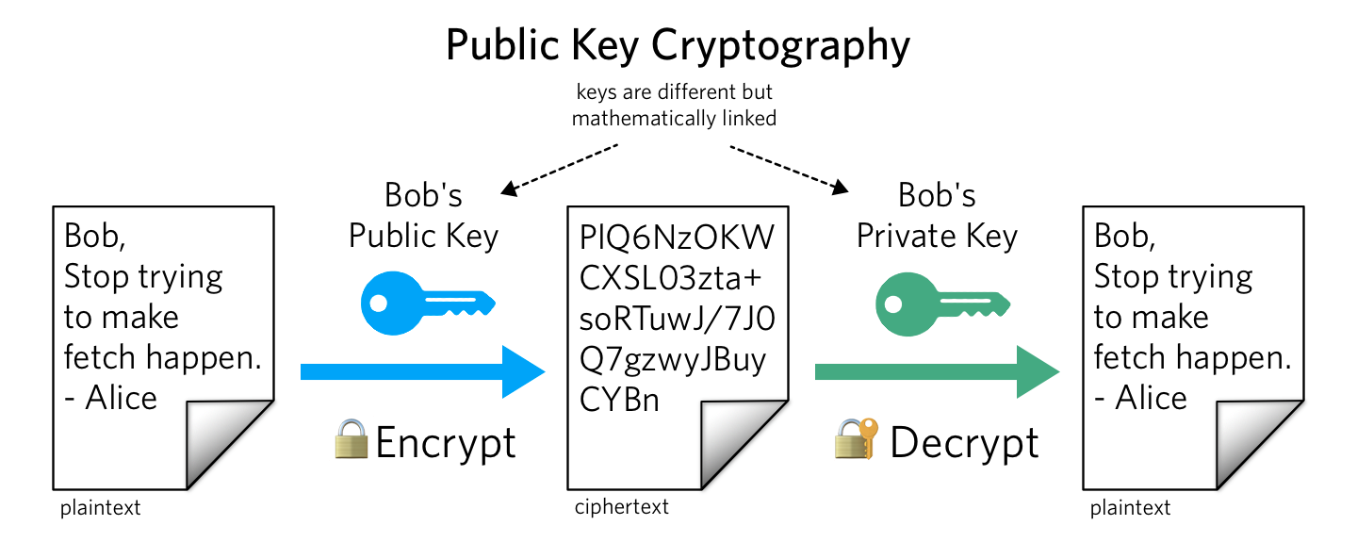

Slide 5
Properties
Different keys are used for encryption and decryption. This is a property which set this scheme different than symmetric encryption scheme.
Each receiver possesses a unique decryption key, generally referred to as his private key.
Receiver needs to publish an encryption key, referred to as his public key.

Slide 6
Properties (2)
Some assurance of the authenticity of a public key is needed in this scheme to avoid spoofing by adversary as the receiver. Generally, this type of cryptosystem involves trusted third party which certifies that a particular public key belongs to a specific person or entity only.
Encryption algorithm is complex enough to prohibit attacker from deducing the plaintext from the ciphertext and the encryption (public) key.
Though private and public keys are related mathematically, it is not be feasible to calculate the private key from the public key. In fact, intelligent part of any public-key cryptosystem is in designing a relationship between two keys.

Slide 7
RSA
Rivest Shamir Adleman

Slide 8
Let’s do some mathematics
Prime numbers: 2, 3, 5, 7, 11, 13, …
X is a prime number if it can only be divided by X or 1
9 and 10 are not prime numbers
Relatively prime numbers
X and Y are relatively prime if they do not have any common divider other than 1
9 and 10 are relatively prime

Slide 9
Some logic
The totient function 𝜑(n)
Gives the number of numbers smaller than n and relatively prime to n
𝜑(4) = 2
𝜑(5)= 4
𝜑(6)= 2
𝜑(10) = 4
𝜑(143) = ?
If n is a prime number, then 𝜑(n) = ?
If n is the product of two distinct prime numbers p and q, then 𝜑(n) = (p-1)(q-1)

Slide 10
MORE MATHS
Modular arithmetic
a mod n: the rest of the division of a by n
5 mod 3 = 2
Some properties
(a+b) mod n = (a mod n + b mod n) mod n
13 + 17 mod 5 = 0 = (3 + 2) mod 5 =
(13 mod 5 + 17 mod 5) mod 5
(a*b) mod n = (a mod n * b mod n) mod n
7*3 mod 5 = 1 = (2 * 3) mod 5
= (7 mod 5 * 3 mod 5) mod n
7 is the multiplicative inverse of 3 (mod 5)

Slide 11
MORE MATHS
X will have a multiplicative inverse mod Y if and only if X and Y are relatively prime
Does 4 have a multiplicative inverse mod 3?
Does 4 have a multiplicative inverse mod 8?
Does 4 have a multiplicative inverse mod 6?
Hint: 6=2x3 !

Slide 12
MORE MATHS
Modular Exponentiation
7 mod 5=2, 7² mod 5=4, 7³ mod 5=3, 7⁴ mod 5=1, 7⁵ mod 5=2, …
8 mod 6=2, 8² mod 6=4, 8³ mod 6=2, 8⁴ mod 6=4, …
8⁵ mod 6 = 8³ mod 6 = 8 mod 6= 2
8³ mod 6 = 8³ ^{mod 2} mod 6= 8 mod 6 = 2
8⁵ mod 6 = 8^{5 mod 2} mod 6= 8mod 6 = 2
Why “mod 2”? Because 𝜑(6)=2

Slide 13
AND A LITTLE MORE
X^{y} mod n = X^{y} ^{mod 𝜑(n)} mod n
Valid only when n is a prime or the product of distinct primes
Particular case: if y mod 𝜑(n) = 1
Then, X^{y} mod n = X^{y mod 𝜑(n)} mod n = X mod n
Very important for RSA !

Slide 14
RSA
Rivest, Shamir, Adleman
Use a large n such that
n = p x q, where p and q are large prime numbers
Choose e relatively prime to n (3?)
(e,n) is the public key
Encrypting message m with it: c=m^{e} mod n
Choose d such that e.d = 1 mod 𝜑(n)
(d,n) is the private key
Decryption: m=c^{d} mod n (why)?
Because c^{d} mod n=(m^{e} mod n)^{d} n = m^{e.d} mod n= m^{e.d 𝜑(n)} mod n= m mod n
Works the same way when encrypting with the private key and decrypting with the public key

Slide 15
END

